Slide 1
The Purchasing Process
Chapter 2

Slide 2
Chapter Overview
Purchasing objectives
Strategic supply management roles and responsibilities
Improving the procure-to-pay process
Approval, contract, and purchase order preparation
Types of purchases
Improving the purchasing process

Slide 3
Roles and Responsibilities
Overall
Goals
Tactical Responsibilities
Strategic
Roles

Slide 4
Elements of the Purchasing Process
Identify user requirements
Evaluate user needs effectively and efficiently
Identify suppliers to meet that need
Develop agreements with suppliers

Slide 5
Elements of the Purchasing Process
Develop ordering mechanism
Ensure payment occurs promptly
Ascertain that need was effectively met
Drive continuous improvement

Slide 6
Purchasing Objectives
Supply assurance
Manage sourcing process efficiently and effectively
Supplier performance management
Develop aligned goals with internal stakeholders
Develop integrated supply strategies that support business goals and objectives

Slide 7
Supply Continuity
Source products/services at right price
Source them from right source
Source them at right specification that meets users’ needs
Source them in right quantity
Arrange for delivery/service performance at right time to right internal customer

Slide 8
Manage Sourcing Process
Determine staffing levels
Develop and adhere to administrative budgets
Provide professional training and growth opportunities for employees
Introduce improved buying channels within procure-to-pay systems

Slide 9
Supplier Performance Management
Select competitive suppliers
Identify new suppliers with high potential and develop closer relationships
Improve existing suppliers
Develop new suppliers that are not competitive with current suppliers

Slide 10
Develop Aligned Goals with
Internal Stakeholders
Consider internal customers as stakeholders
Establish strong cross-boundary communication
Develop cross-functional coordination and collaboration
Develop positive, problem-solving relationships

Slide 11
Develop Integrated Strategies that Support Goals and Objectives
Match functional supply goals with organizational goals
Become mutually-supportive, not counter-productive
Leverage supply management’s substantial impact on firm’s bottom line
Utilize supply management as strategic core competency

Slide 12
Reasons for Not Being Strategic
Supply management personnel have not historically participated in senior-level corporate planning
Executive management has not always recognized benefits of world-class supply management

Slide 13
Supply Market Intelligence
Updates on supply market conditions and trends
Identify emerging materials and service technologies
Develop supply options and contingency plans to reduce risk
Support requirements for diverse and globally competitive supply base

Slide 14
Strategic Supply Management Roles and Responsibilities
Spend analysis
Demand management and specifications/statements of work
Category management and supplier evaluation/selection
Contract management

Slide 15
Strategic Supply Management Roles and Responsibilities
Cost management
Managing procure-to-pay process
Supplier relationship management
Establish a supply management strategy

Slide 16
Spend Analysis
Process of collecting historical data by commodity
Drive all spend to a unit or rate of consumption
Used to drive strategies in …
  Demand management
  Commodity management
  Risk management

Slide 17
Demand Management and Specifications/SOWs
Process of using consumption data to forecast and estimate future consumption
Optimize sourcing strategies
Proactively set policies, procedures, and measurement systems
Ensure appropriate levels of capacity in supply base to minimize risk

Slide 18
Demand Management and Specifications/SOWs
Establish fixed set of standards to limit options
Restrict supply base to include only preferred suppliers that meet risk and compliance requirements
Challenge product and service specifications to drive out costs
Review and develop statements of work

Slide 19
Category Management and Supplier Evaluation/Selection
Process of developing insights into…
  Stakeholder requirements
  External industry intelligence
  Supply base capabilities
  Operational risks
  Strategy development
Identify competitive value

Slide 20
Category Management and Supplier Evaluation/Selection
Category strategy elements
  Business case to identify rationale for plan
  Risk mitigation plan
  Business value derived from implementation
  Negotiation plan
  Supplier scorecard
  Sourcing work plan

Slide 21
Contract Management
How to award contracts
  Competitive bidding
    How many suppliers to bid?
  Negotiation
    Use of cross-functional team?
  Some combination of both
Supply management has ultimate responsibility for the contract

Slide 22
Contract Management
Definition
  “A process associated with defining the contract, defining roles and responsibilities of both parties, and advising when to modify and ensure appropriate escalation.”
Need for …
  Accuracy in terms and conditions
  Alignment with category strategy, required service levels, and periodic audits

Slide 23
Contract Management
Need to trigger proactive sourcing prior to contract expiration
Maintenance of contract database
Initiation of compliance and/or improvement actions when less-than-desirable supplier performance occurs

Slide 24
Cost Management
Understand true cost of purchased goods and services
  Unbundling price paid and various components over product lifecycle
  Deliver a target cost and a unit rate
Use of decision-support tools and techniques

Slide 25
Cost Management
Develop insights to …
  Cost of supporting a process or commodity
  The gap between cost drivers and assumed business case
  Identify the business case
  Total cost of offering a service
  Development of cost models

Slide 26
Managing the Procure-to-Pay Process
Automation of all transactional activities including …
  Requisitioning
  RFX (i.e., RFI, RFP, RFQ)
  Contract award
  Orders
  Approval
  Receipt
  Payment

Slide 27
Supplier Relationship Management
Day-to-day transactions
Identification and mitigation of operational risk and deliverables
Business continuity planning
Understanding suppliers’ business challenges
Identification of opportunities to improve value and reduce cost

Slide 28
Supplier Relationship Management
Establishing supplier scorecard metrics and reviewing progress
Contract terms and conditions (i.e., the T’s and C’s)
Leveraging flow of information between key internal process owners and suppliers

Slide 29
Establish a Supply
Management Strategy
Repeatable and well-defined process for building strategy and governance
Clear alignment with executive vision and internal user-specific business goals
Process based on well-developed supplier market intelligence and internal stakeholder inputs

Slide 30
Establish a Supply
Management Strategy
Established goals and metrics for short-term project plans and longer term plans
Established procurement transformation initiatives
Established communication plan to inform senior management
  Update and review against defined goals and objectives

Slide 31
Improving the Procure-to-Pay Process
How much relative effort a company spends on P2P differs greatly between sourcing situations
Companies can use a superior P2P process to create competitive advantage

Slide 32
Stages of the Procure to Pay Process
Forecast and plan requirement
Need clarification (requisition)
Supplier identification/selection
Contract/purchase order generation
Receipt of material or service and documents
Settlement, payment, and measurement of performance

Slide 33
Benefits of E-Procurement
Virtual elimination of paperwork
Reduced time between need recognition and order release and receipt
Improved communication
Reduction in errors
Reduction in overhead costs
Reduction in P.O. and invoice processing time

Slide 34
Procure to Pay Process Map
Projects
Internal Customers
Operations
Start
End
Forecast & Plan Requirement
Need Clarification/ Requisition
Supplier Identification& Selection
Approval & Contract/ P.O. Generation
Receive Material & Documents
Settle, Pay, & Measure Performance
Supplier Need Fulfillment
Enablers: Finance, Legal, Human Resources, Information Technology

Slide 35
Forecast and Plan Requirement
Need is beginning of purchasing cycle
Sources of need
  Annual or biannual planning process
  New product development process
  Operational needs
Extensive information flows
Sometimes, actual needs are difficult to define clearly

Slide 36
Forecast and Plan Requirement
Types of needs
  Components
  Raw materials
  Subassemblies
  Finished goods
  Services
Unplanned needs
Ongoing need vs. spot buy

Slide 37
Needs Clarification: Requisitioning
Purchase requisitions and/or statements of work
Traveling purchase requisitions and/or bar codes
Forecasts and customer orders
Reorder point system
Stock checks
Cross-functional sourcing teams

Slide 38
Elements of a Purchase Requisition
Description of required material or service
Quantity required
Estimated unit cost
Operating account to be charged
Date of requisition
Date required
Authorized signature

Slide 39
Statement of Work
Used for procuring services
Specifies …
  Work to be completed
  When it is needed
  What type of service provider required

Slide 40
Statement of Work
Other details
  Required training
  Site safety
  Liability and insurance
  Uniforms
  Background checks

Slide 41
Traveling Purchase Requisition/
Bar Codes
Printed card, label, or bar code
  Description of item
  List of approved suppliers
  Prices paid to suppliers
  Reorder point
  Record of usage
Conserves time for ordering routine materials and supplies

Slide 42
Forecasts and Customer Orders
Anticipated customer orders
Actual customer orders
Customized product orders for specific customers
New product development
MRP systems

Slide 43
Reorder Point System
Computerized system to track on-hand inventories, order quantities, and demand forecasts
Predetermined order point and order quantity
  When on-hand inventory level hits order point, standard order quantity is generated

Slide 44
Stock Checks
Sometimes called cycle counts
Physical checking of inventory
  Verify actual on-hand inventory (POH)
  Make necessary adjustments to item inventory record
Inventory may be misplaced, lost, damaged, short-shipped, or stolen
  Results in inaccurate inventory records (ROH)

Slide 45
Cross-Functional Sourcing Teams
Used to proactively determine sourcing needs
Identify potential suppliers before need occurs
  Faster order cycle times
  Better supplier evaluation and selection

Slide 46
Description
By market grade or industry standard
  Well-understood specifications for standard items
  Common agreement on what terms mean
By brand
  Proprietary or unique products
  Brand provides perceived advantage to user

Slide 47
Description
By specification
  Materials used
  Manufacturing or service steps required
  Physical dimensions
By performance characteristics
  Focus on customer’s desired outcomes
Prototypes or samples

Slide 48
Supplier Identification and Selection
Existing supplier
  Familiarity and track record
  List of preferred suppliers
New supplier
  Problem of maverick spending
  Need to identify potential suppliers
  Need to evaluate and qualify
  Negotiate or competitive bidding?

Slide 49
Maverick Spending
User selects different supplier than supply management has approved
May be acceptable when there is small chance of risk
Loss of opportunity to control cost and/or leverage purchase volume
Exposes firm to greater risk

Slide 50
Supplier Identification and Selection
Bidding vs. negotiating
Request for quotation
Specifications or blueprints
Supplier evaluation

Slide 51
When to Use Competitive Bidding
Volume is sufficiently high
Specifications or requirements are clear to supplier
Marketplace is competitive (i.e., adequate # of suppliers)
Buyers solicit bids only from technically qualified suppliers who want contract

Slide 52
When to Use Competitive Bidding
Adequate time is available for suppliers to evaluate RFQ
Buyer does not have preferred supplier for particular item

Slide 53
When to Use Negotiation
Any criteria for competitive bidding are missing
Purchase requires agreement on wide range of performance factors other than price
Buyer requires early supplier involvement

Slide 54
When to Use Negotiation
Supplier cannot determine risks and costs before contract is awarded
Supplier requires substantial lead time to develop and produce requested item(s)

Slide 55
Request for Quotation
Supply management invites quotes or bids from pool of potential suppliers
Consists of necessary information to allow supplier to accurately respond
Includes due date of bid
Defines whether substitute offers are acceptable
Normal practice is minimum of 3 bids

Slide 56
Specifications or Blueprints
Used for …
  Complex products or services
  Untested or new production processes
Consists of …
  Detailed blueprints
  Samples
  Technical drawings
May include use of RFP

Slide 57
Evaluate Suppliers
Evaluation of potential supplier pool
  Pre-qualification of capable suppliers
  Development of selection criteria
  Design supplier evaluation process
Reverse auctions (or e-auctions)
  Low bids garnered electronically in real-time

Slide 58
Purchase Order
Drafted after supplier evaluation and selection is completed
Legally-binding document (i.e., contract)
  Carefully define terms and conditions
  Standard legal language (i.e., “boilerplate”)
  Offer and acceptance
Visibility throughout company

Slide 59
Purchase Order
Quantity
Material specification
Quality requirements
Price
Delivery date
Method of delivery
Ship-to address
P.O. number
Order due date
Name and address of buyer

Slide 60
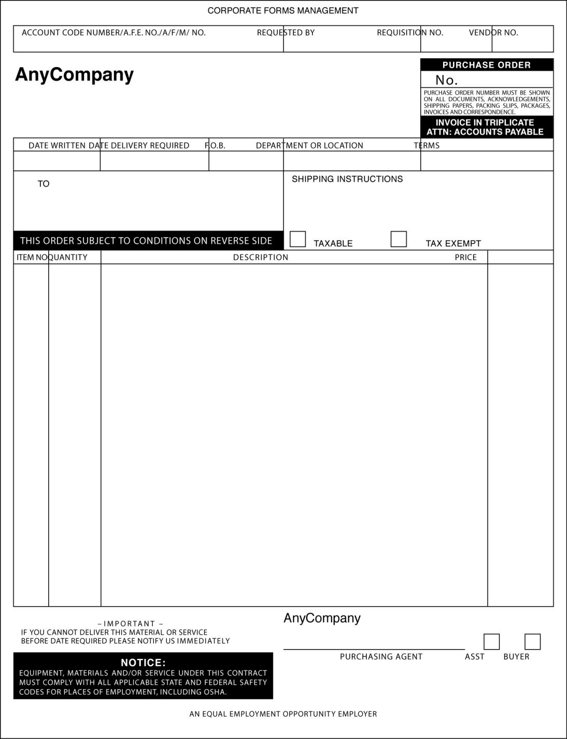
Typical Purchase Order Form

Slide 61
P.O. Visibility
Accounting (accounts payable)
Requisitioner or requesting department
Receiving
Traffic management
Supply management
Quality control

Slide 62
Blanket Purchase Order
Usually open for 1 year
Used for repeated purchases of item or family of items
Release materials as needed vs. issuing new P.O. each time
P.O. remains open during specified term
Importance of escape clause

Slide 63
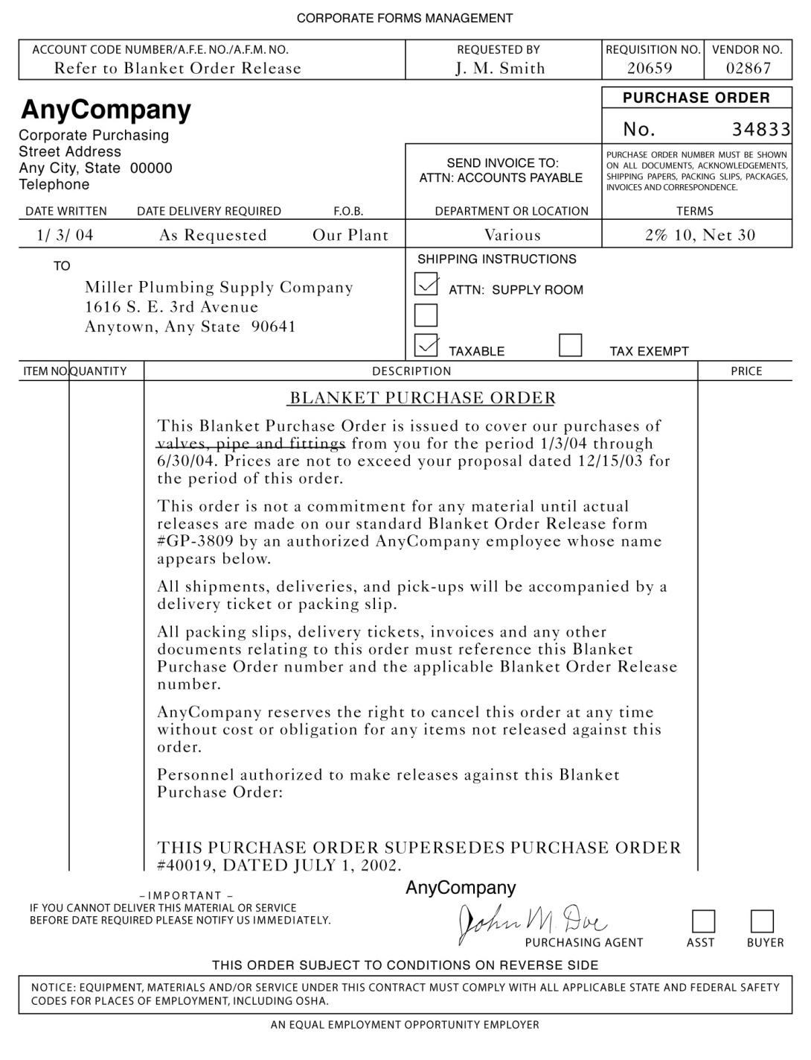
Blanket Purchase Order Form

Slide 64
Material Purchase Release
Used to release shipments under blanket P.O.
Provides notification to supplier about forecasted and actual needs
User oftentimes makes actual order release
Increasingly electronic

Slide 65
Types of P.O.s
Fixed-price contracts
  Financial risk – market fluctuations
  Industry competition
  Levels of supply
  Market prices
  Technology risk

Slide 66
Types of P.O.s
Cost-based contracts
  Expensive, complex, and critical purchases
  Risk of large contingency fee
  Need to identify and monitor relevant supplier costs

Slide 67
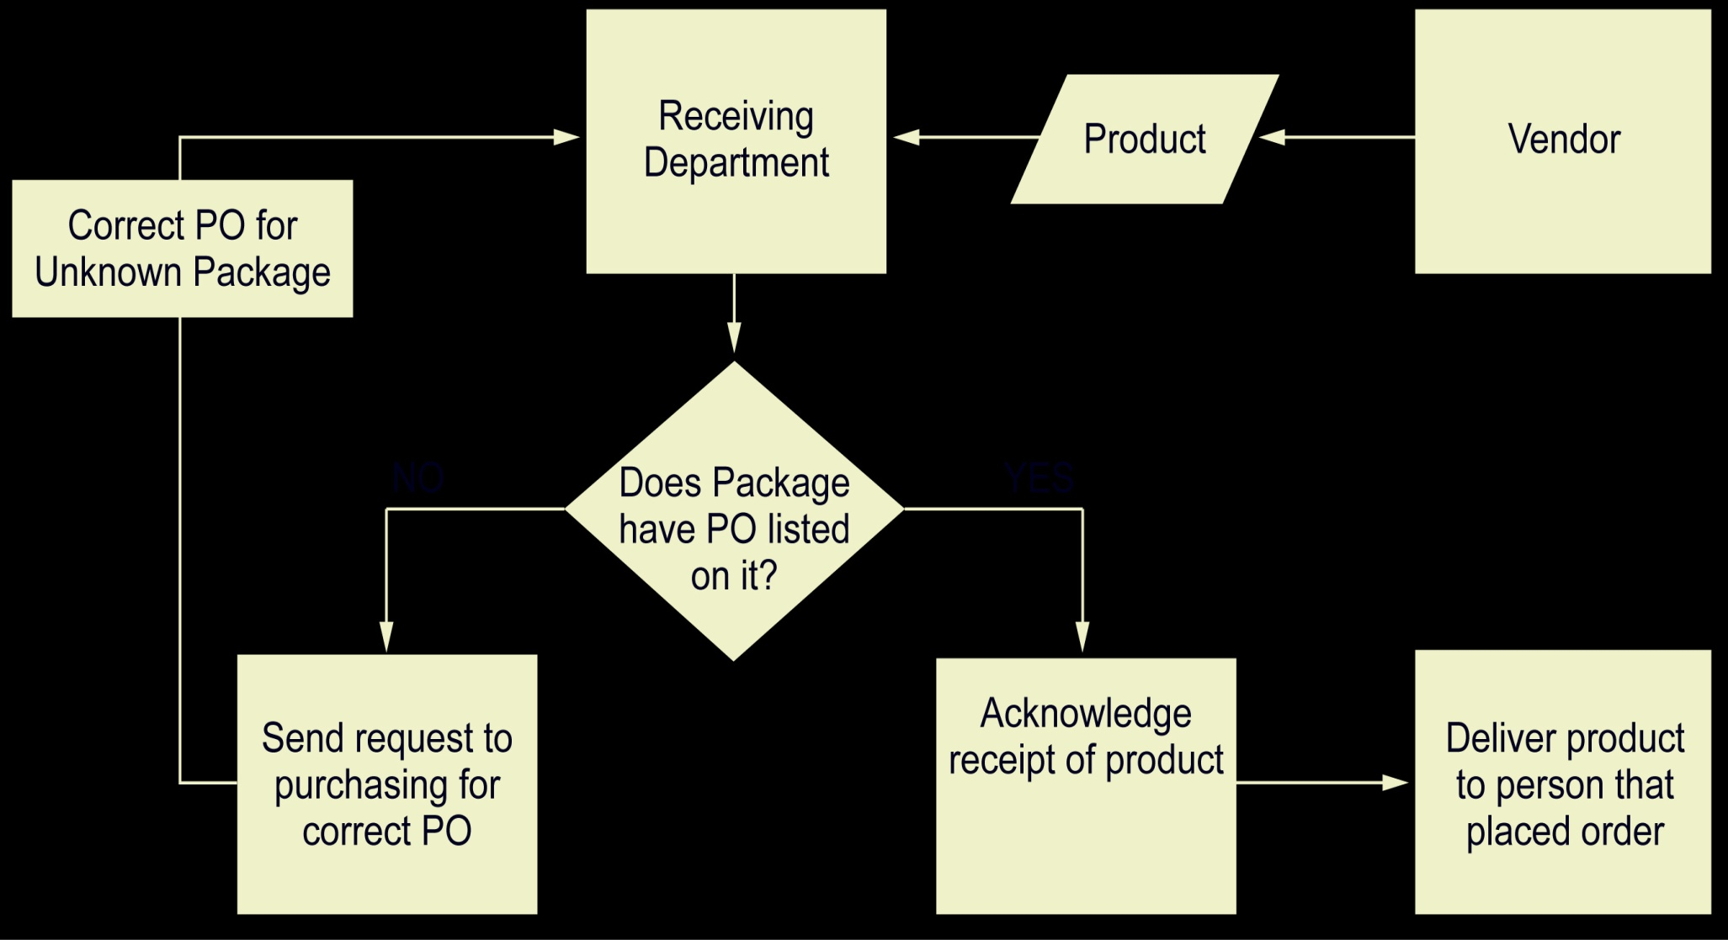
Receiving Process

Slide 68
Receipt and Inspection
Electronic vs. paper documents
  Acknowledgement and receipt
Material packing slip
  Details contents of shipment
Bill of lading
  Transfers ownership and possession
Receiving discrepancy report
  Shortages and overages

Slide 69
Receipt and Inspection
Invoice settlement and payment
Records maintenance
  Supplier performance database
Continuously measure and manage supplier performance
  Purchasing cycle does not end with receipt of goods or services
  Frequency of evaluation and feedback

Slide 70
Invoice Settlement and Payment
3-way match required to pay invoice
  P.O.
  Invoice
  Receiving report
Electronic funds transfer (EFT)
Summarized monthly payments vs. paying for each P.O. individually
Mostly done electronically

Slide 71
Reengineering Procure to Pay
Secure top management support for initiative and project budget
Map existing P2P process, highlighting problems
Understand needs and requirements of user groups
Utilize cross-functional review team, including users and suppliers as appropriate

Slide 72
Reengineering Procure to Pay
Explore technology solutions with ERP systems
Define new process and conduct pilot test
Train and deploy other users (rollout)
Monitor, update, and improve system

Slide 73
Types of Purchases
Raw materials
Semifinished products and components
Finished products
Maintenance, repair, and operating (MRO) items

Slide 74
Types of Purchases
Production support items
Services
Capital equipment
Transportation and third-party logistics providers

Slide 75
MRO Purchasing
Most organizations do not track MRO items with same intensity as with production items
There are typically too many MRO suppliers
There are too many small orders which take up too much time

Slide 76
Procuring Capital Equipment
Assets to be used > 1 year
Standard general equipment vs. customized equipment
Features of CE procurement
  Irregular frequency
  Requires large sums of money
  Highly sensitive to general economic conditions

Slide 77
Transportation and 3PLs
Specialized type of services procurement
Need to evaluate and select transportation service providers just like production item suppliers
Evaluate capability of service providers to coordinate wide range of logistics services

Slide 78
Improving the Purchasing Process
Online requisitioning systems from users to purchasing
Procurement cards issued to users
E-commerce using the Internet
Longer-term purchase agreements
Cloud-based ordering systems

Slide 79
Advantages of Cloud-Based Ordering
Immediate visibility to backorders
Faster order input time
Reduced ordering errors
Order tracking capability
Order acknowledgement from supplier
Ability to batch multiple items from multiple users into single order
Faster order cycle time

Slide 80
Improving the Purchasing Process
Purchasing process redesign
  Coordination of subprocesses
Electronic data interchange (EDI)
Online ordering through e-catalogs
Allowing users to contact suppliers directly
  Convenience ordering system
  Reduced administrative burden

